Slide 1
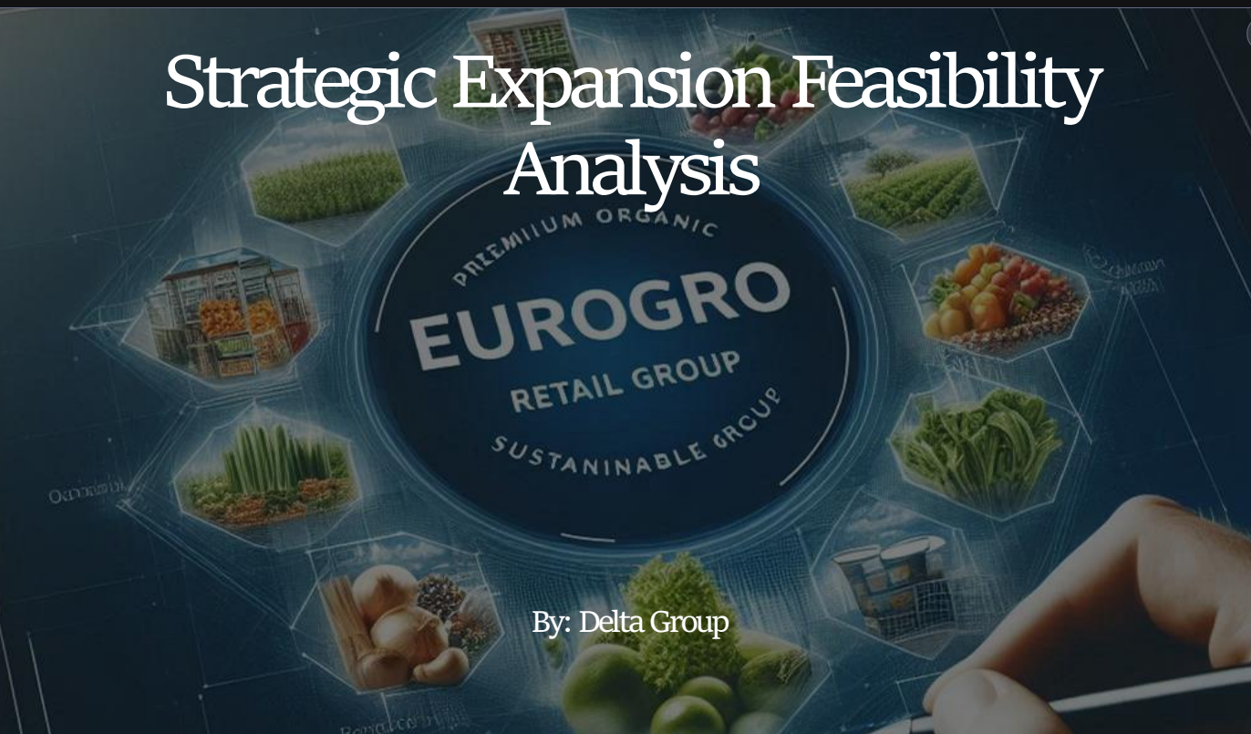

Slide 2

Executive Summary
This report presents the outcome of a 2-week strategic feasibility assessment for EuroGro Retail Group’s proposed expansion into Lisbon, Portugal. The project evaluated market potential, financial viability, human resource readiness, and operational risks.
Based on evidence drawn from customer analytics, financial modelling, HR benchmarking, and stakeholder input, the feasibility report recommendation is a GO decision; to proceed with the Lisbon expansion under the Base Case scenario, with proactive risk mitigations in place.

Slide 3
Project Overview
Project Title: Strategic Expansion Feasibility – Lisbon
Sponsor: EuroGro Executive Leadership
Project Manager: Agile Project Managers
Project Duration: 2 Weeks
Project Team: Business Analyst, Data Analyst, Financial Analyst, HR Analyst

Slide 4





Project Objectives
VALIDATE LISBON AS A STRATEGIC MARKET ENTRY POINT.
ESTIMATE CAPITAL AND OPERATIONAL EXPENDITURES, BREAK-EVEN POINT & ROI UNDER DIFFERENT SCENARIOS
ASSESS THE LOCAL TALENT MARKET AND HR COMPLIANCE REQUIREMENTS.
IDENTIFY INTERNAL AND EXTERNAL STAKEHOLDERS AND ELICIT REQUIREMENTS FOR BUSINESS ALIGNMENT.
DELIVER DATA-DRIVEN RECOMMENDATIONS TO LEADERSHIP.

Slide 5





Methodology
Data-driven Market Research using Power BI dashboards and data segmentation.
Financial Modelling of three scenarios (Optimistic, Base, Pessimistic) using Excel.
HR Benchmarking with labour law reviews and hiring feasibility in Lisbon.
Stakeholder Interviews with HR, Financial Analyst, and Project Manager.
Agile Tools used are Jira, Google Meet & Google Drive for collaboration and workflow management.

Slide 6
Stakeholder Needs
01
02
03
04
Human Resources
1. Define job roles and salary benchmarks for Lisbon-based staff.
2. Localised onboarding and legal-compliant HR processes
3. Track hiring KPIs and ensure Portuguese labour law adherence
Finance
1. Maintain a live CapEx/OpEx model with scenario forecasting.
2. Track category-level costs and present ROI, break-even data
3. Automate financial reporting and integrate data into Power BI
Data & Marketing
1. Segment customers by demographics and behaviour (personas).
2. Align campaigns with customer journey stages
3. Support pricing strategy based on income and purchase frequency
Store Operations & IT
1. Configure POS for loyalty integration, self-checkout, and multilingual UI.
2. Align store layout to traffic patterns and organic-first shelf logic
3. Ensure systems uptime (>99.5%) and GDPR-compliant data handling

Slide 7

Key Findings:
Finance
Capital & Operating Expenditure
CapEx (One-time): €305,000
OpEx (Monthly):
€55,167
Return on Investment (ROI)
Optimistic Scenario: ROI >100%
(High profitability)
2. Base Scenario: Moderate ROI 30%
(Sustainable returns)
3. Pessimistic Scenario: Negative ROI
(Financial risk)
Break-even Analysis
1. Optimistic: Break-even in 2 months
2. Base: Break-even in 15 months
3. Pessimistic: Break-even not achievable within 24 months

Slide 8




Key Findings: Market
Market Potential:
Lisbon exhibits high demand for organic products, especially among young adults and families.
Strong interest in loyalty programs (GroPoints) across personas.
Competitive Landscape:
Existing retail Chains: Pingo Doce, Continente, and Lidl dominate the Lisbon market.
Gap in Premium Organic Space:
Limited competition in the mid-tier premium organic market.

Slide 9



Key Findings: HR
Hiring Strategy:
1. Use a phased recruitment approach
2. Partner with local job boards and staffing agencies to reduce time-to-hire
3. Offer competitive packages including health, bonuses, and non-cash benefits
Labour Law Compliance:
Adhere to Portuguese labour law covering:
Employment Contracts, Minimum Wage, Social Security Contributions, Language Requirements, Workplace Policies.
Onboarding Plan:
Implement a 2-week structured onboarding program covering:
Company orientation, safety compliance, team integration, Role-specific training, customer service expectations, and job shadowing

Slide 10
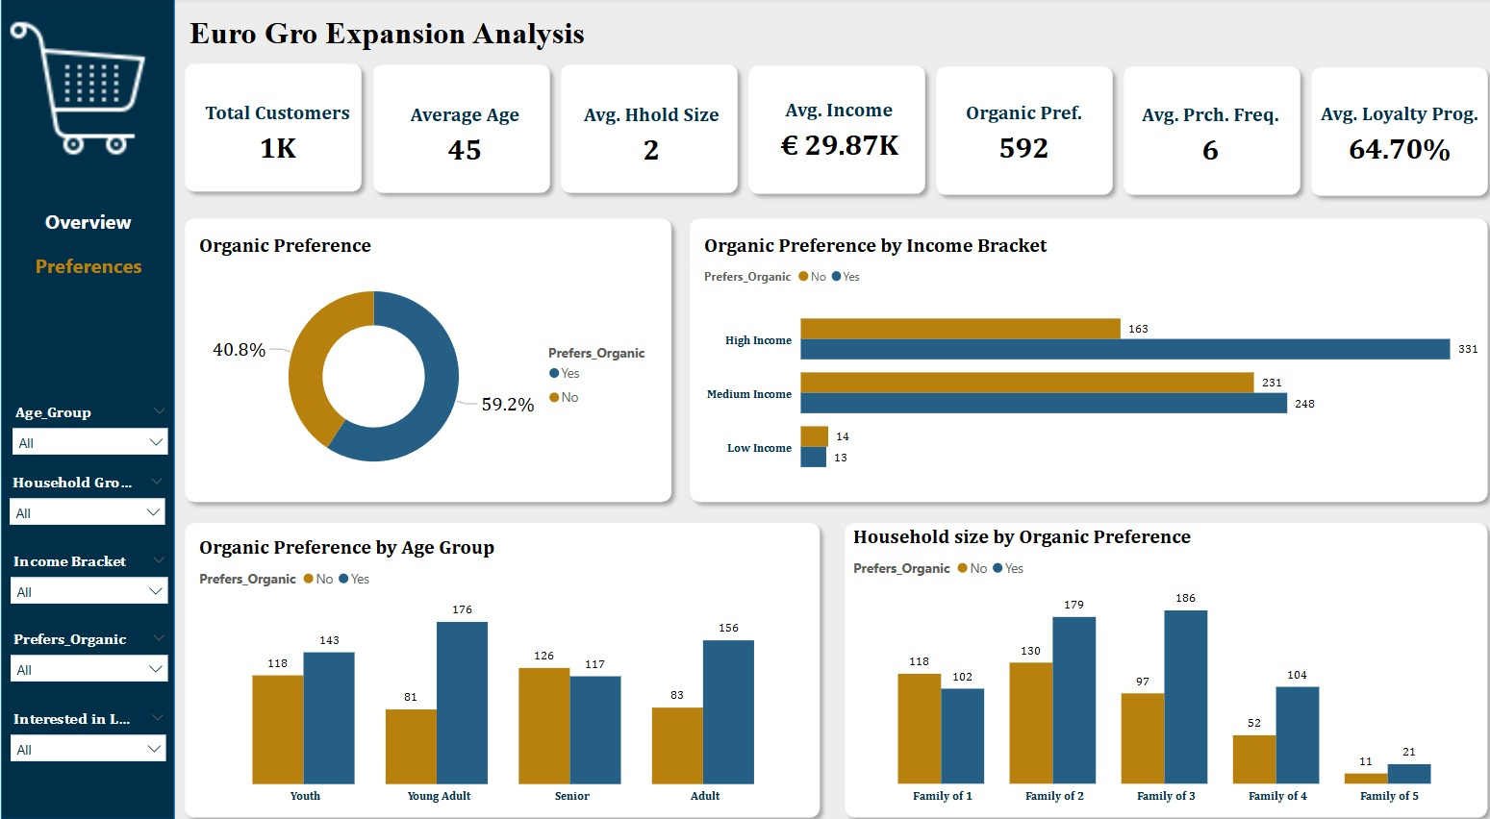

Slide 11
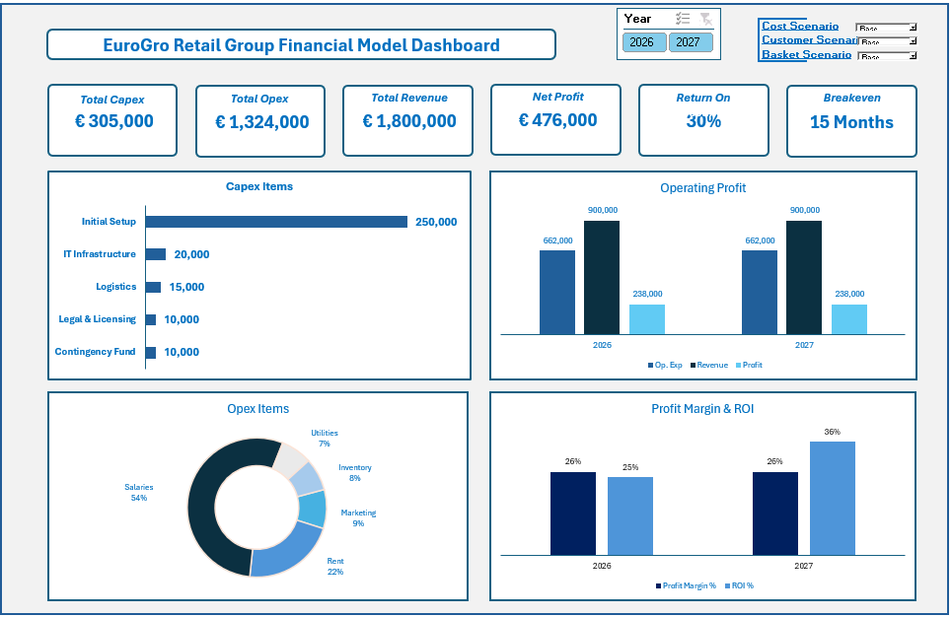

Slide 12




Risk and Mitigation
Time Constraints:
Initiate legal process early, adopt a phased rollout & ensure weekly cross-functional sync
Budget Constraints:
Prioritise essentials, implement cost-control measures & negotiate rates with vendors
Add a 10% buffer to the budget
Legal & Compliance Constraints:
Comply fully with Portuguese labour laws and partner with local HR consultant
Operational & Resource Constraints:
Localize systems and training, partner with bilingual recruitment and logistics providers
Technical Constraints:
POS, inventory, and reporting systems must be fully integrated before launch.

Slide 13

Recommendations
Market Entry: Go
Market data-driven
1. Strong demand for organic products in Lisbon, especially among young professionals and families.
2. Loyalty program (GroPoints) has high engagement potential.
3. A competitive gap exists in the mid-tier organic retail market.
4. Favourable regulatory climate for retail growth.
Financial Viability: Sustainable
1. The base scenario shows positive ROI and break-even within 15 months.
2. Optimistic case yields rapid profit within 2 months.
3. The pessimistic case is not viable but manageable with cost control and revenue strategies.
HR Readiness: Ready
1. Talent is available for bilingual retail staff.
2. Legal onboarding, localised training, and compliance processes are prioritised.
3. Salary benchmarks and role definitions are clearly outlined.

Slide 14






Conclusion
1. A comprehensive cross-functional assessment was conducted over 2 weeks, covering market demand, financial sustainability, HR readiness, stakeholder needs, and operational risks.
2. The feasibility study utilised Power BI analytics, financial modelling, stakeholder interviews, and HR benchmarking to inform strategic decisions.
3.
Recommendation: Go
5. Financial forecasts under the Base scenario show sustainable profitability and an acceptable break-even period (15 months).
6. HR Hiring and Onboarding plan are ready, with localisation and legal compliance defined
4. Market conditions are highly favourable, with strong customer demand and limited competition in EuroGro’s organic target niche.
Final Decision: Proceed with the Lisbon flagship store launch under the Base Case scenario, supported by clear risk mitigations and a phased operational rollout.

Slide 15
Appendices
This is the link to all the documents for this feasibility report:
https://tinyurl.com/mryr4t37

